Slide 1
Modeling the Impact of Age on Powerlifting
Sarah Sheldon '25 (Statistics) and Josh Larson '25 (Mathematics)
Advisor: Dr. Ivan Ramler (Statistics)
Sarah Module:
Write your research questions here in 2-4 bullet points:
Question 1
Question 2
(Question 3)
Score:
Write your method here in 3-4 bullet points.
How did you carry out this experience? How did you carry out this research?
Did you have a schedule for your Travel Enrichment Grant or Research?
Were there any challenges you needed to navigate?
Josh Module:
What have you done with what you’ve learned from this experience?
How have you integrated/will you integrate this information into your future academic work?
What further questions would you like to explore?
Background:
Write background information here in 4-5 bullet points:
Background Context 1
Background Context 2
Background Context 3
Powerlifting:
*
*
*
*
*
*
Relevant image
Results:
Write your results here:
How did this impact your off-campus study experience?
How did this shape or influence your understanding of your host country?
What did this teach you about your host culture/country?
Relevant image
Sources:
Include citations for any sources. Alternatively, you could include QR codes to relevant museums or websites where someone could learn more.

Slide 2

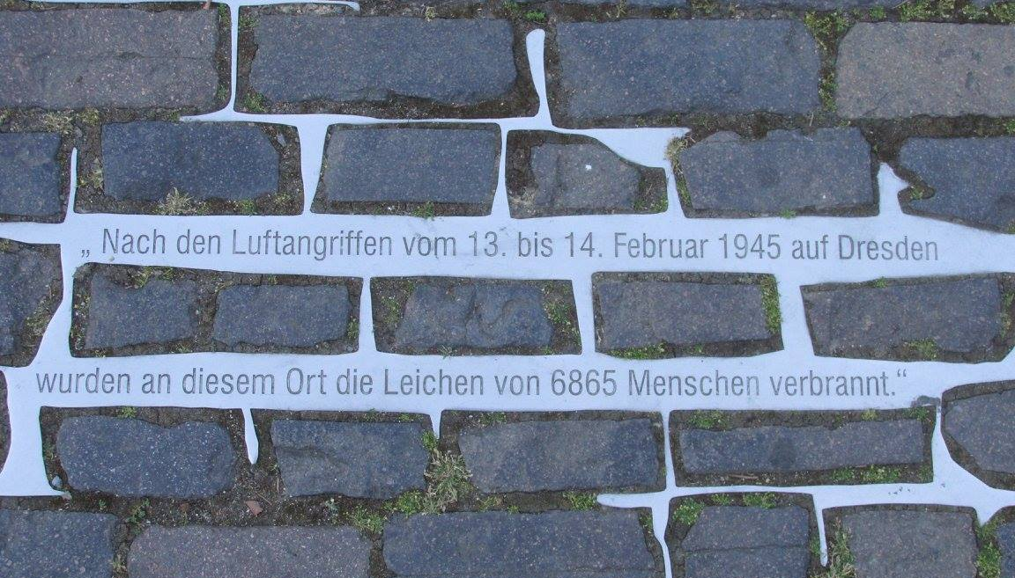
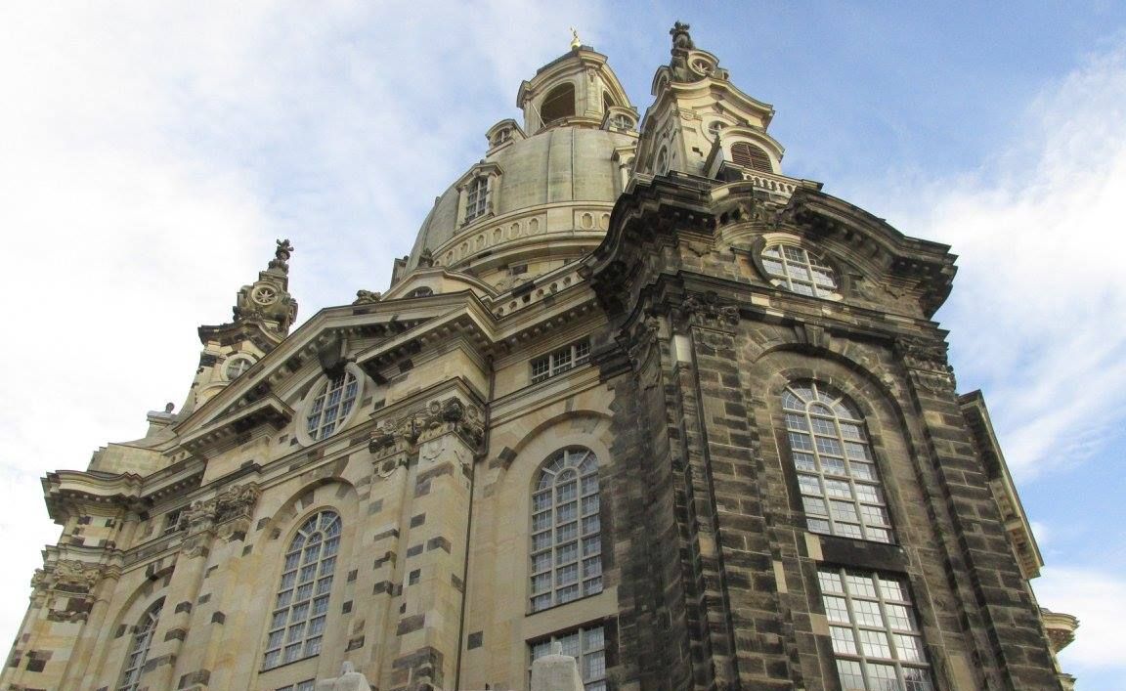
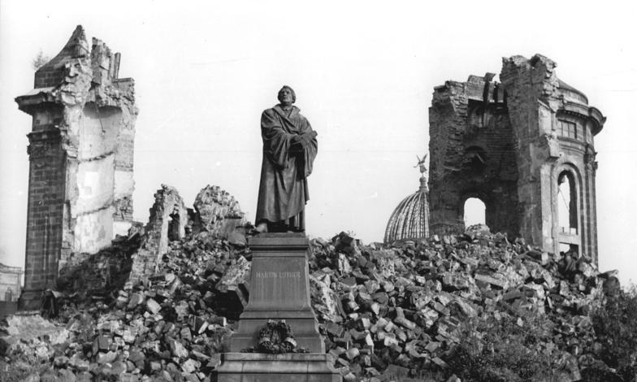
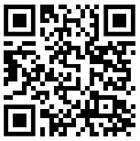
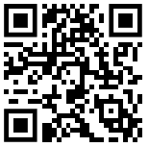
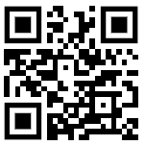
Exploring Postmodernism and Authenticity through the Dresden Frauenkirche
Kim Longfellow ‘24
Freiburg, Germany (Spring 2023) CIIS Travel Enrichment Grant, Supported by the CIIS Fellowships Fund
Abstract:
Through this Travel Enrichment Grant, I received funding to visit Dresden, Germany and study the reconstruction of the Frauenkirche as an example of postmodern architecture and authenticity.
To what extent is the reconstruction of the Frauenkirche an authentic reconstruction of the original church?
Can the Frauenkirche be considered an authentic space? Or is it merely postmodern recreation?
Method:
Funding from the Center for International and Intercultural Studies allowed me to travel to/from Dresden and stay for three nights.
Day 1: Public entry ticket to Dresden Frauenkirche.
Day 2: Walking tour of Dresden; Visit to Museum of Old and New Masters.
Day 3: Tour of the Dresden Frauenkirche dome and museum; evening concert in the Frauenkirche.
Relevant image
Conclusion:
Postmodernism discusses truth as something created by the viewer. The Frauenkirche attempts to be loyal to the original building, but does not intend to be an exact replica. It serves a new function.
Since returning from Germany, my senior research has focused on the Vergangenheitsbewältigung, or the process of coming to terms with the past.
Future research includes analysis of approaches to reconstruction in Hamburg and Berlin.
Background:
The Dresdner Frauenkirche or “Church of Our Lady” was built in Dresden, Germany in the 18th century and was one of the largest domes in Europe.
The Frauenkirche was destroyed in the firebombing of Dresden in 1945, and its charred remains were left in place for 50 years as an anti-war memorial.
Following the reunification of Germany in the early 1990s, the church was rebuilt following the original blueprints using new white stones and the charred black stones of the original church.
Results:
Inclusion of the charred remains of the original serves to highlight its reconstruction, not mask it as the authentic original.
Tours attempt to balance enjoyment of the beauty of the church with a difficult past that must be reckoned with.
The Frauenkirche serves as a way to navigate Germany’s complex role as perpetrator, while mourning the loss of life in the firebombing of Dresden.
By Bundesarchiv, Bild 183-60015-0002 / Giso Löwe / CC-BY-SA 3.0, CC BY-SA 3.0 de, https://commons.wikimedia.org/w/index.php?curid=5429845
Recommended Readings and Resources:
Learn more about the Dresdner Frauenkirche:
/
Learn about the Gemäldegalerie Alte Meister:
Learn about the Albertinum:
Relevant image

